Slide 1
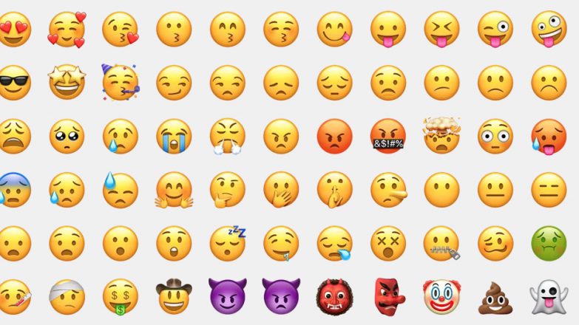
Emojis
And
Animals

Slide 2

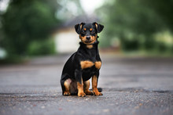

Slide 3

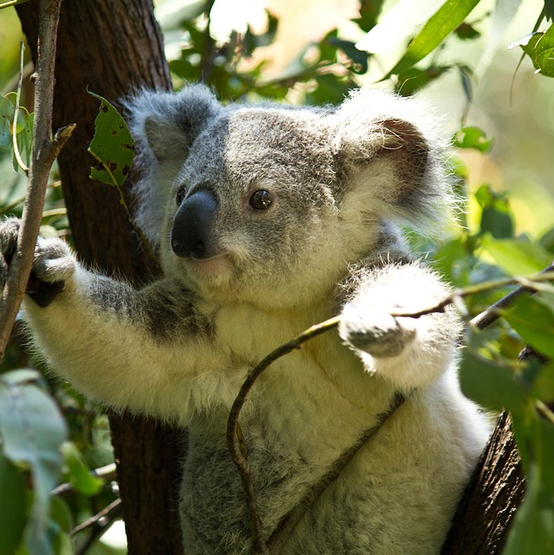

Slide 4

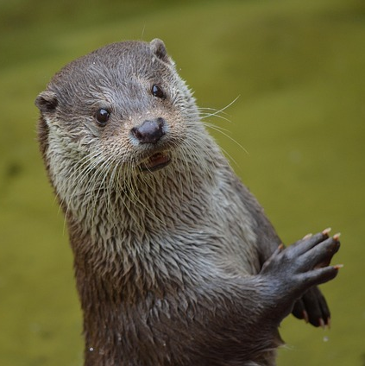

Slide 5

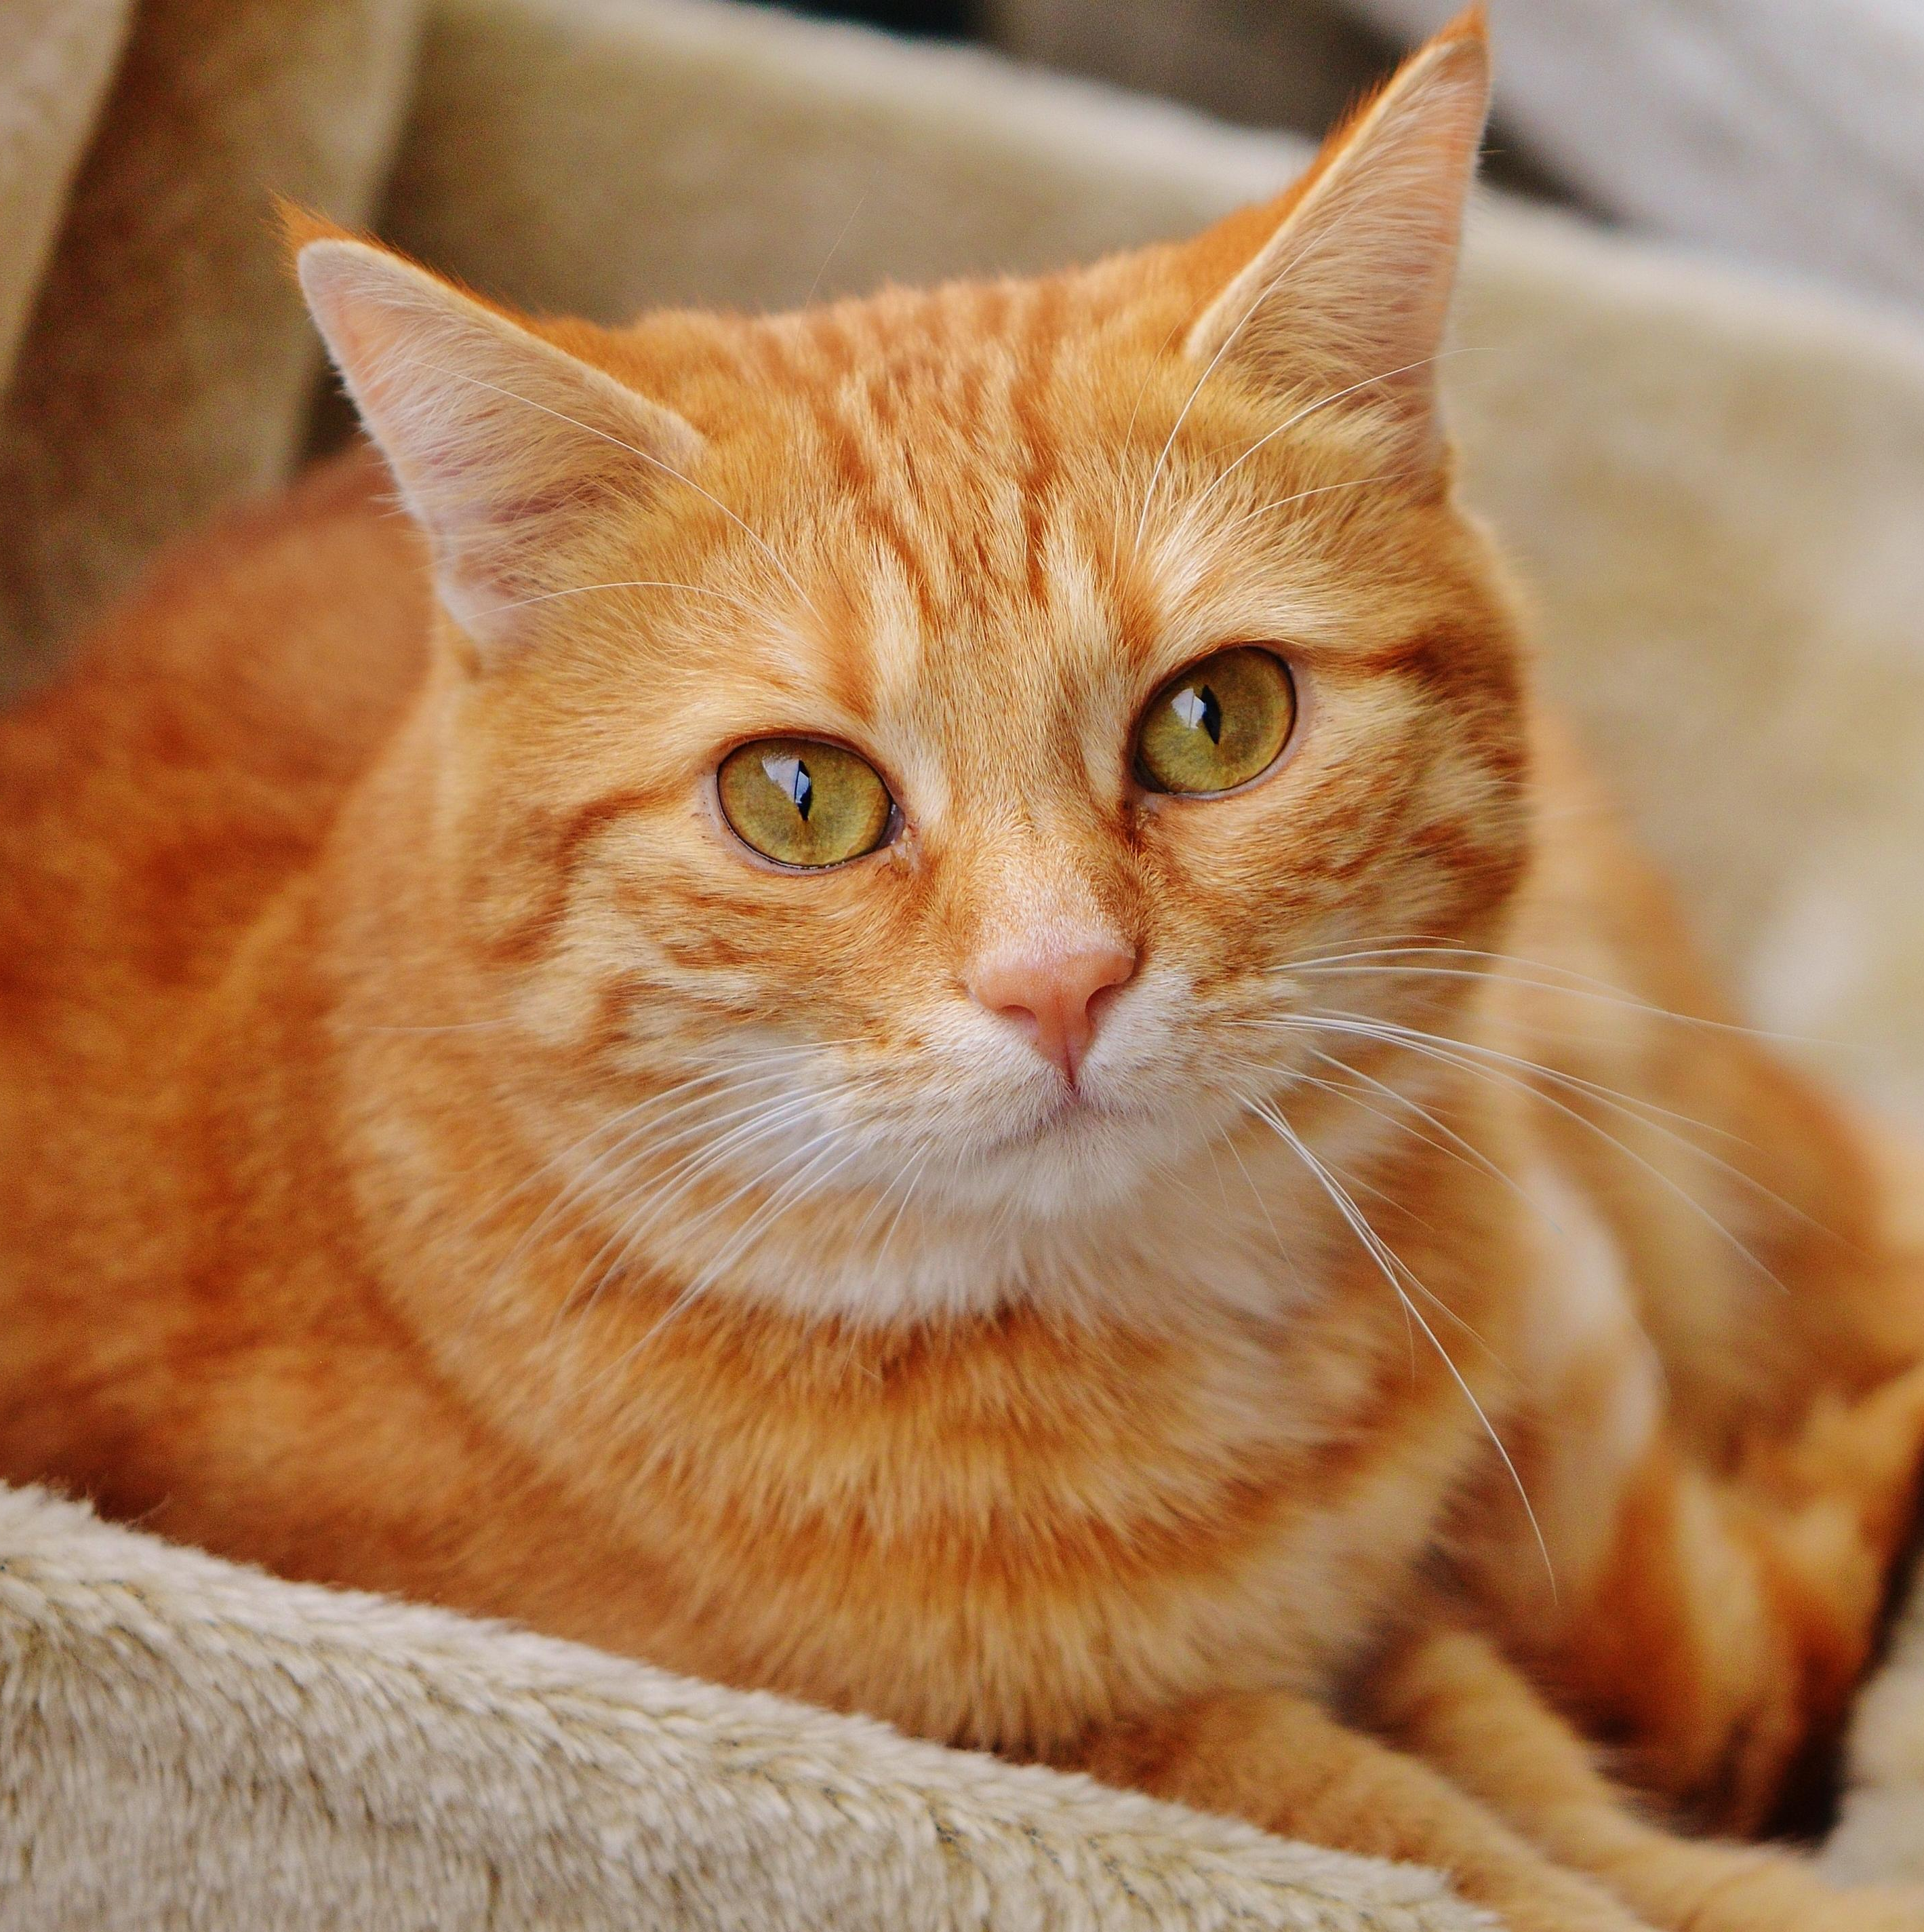

Slide 6
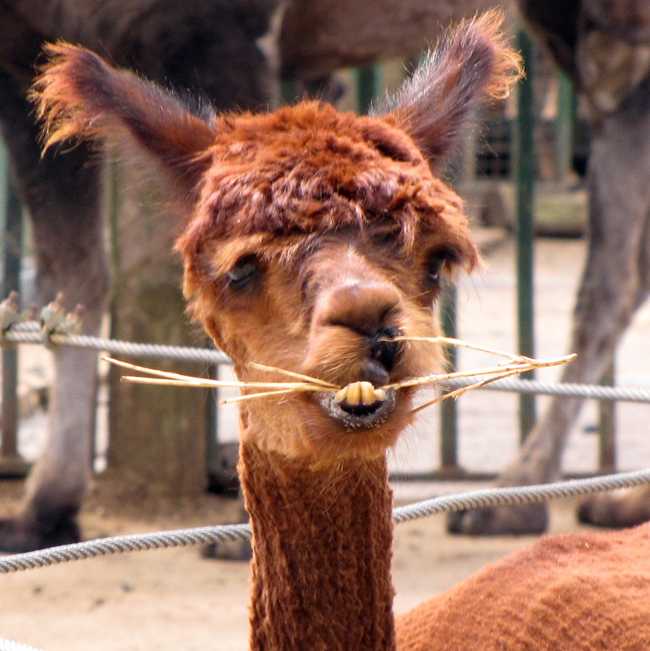

This Photo by Unknown Author is licensed under CC BY-NC
This Photo by Unknown Author is licensed under CC BY-NC
This Photo by Unknown Author is licensed under CC BY-NC
This Photo by Unknown Author is licensed under CC BY-NC
This Photo by Unknown Author is licensed under CC BY-NC
This Photo by Unknown Author is licensed under CC BY-NC
This Photo by Unknown Author is licensed under CC BY-NC
This Photo by Unknown Author is licensed under CC BY-NC
This Photo by Unknown Author is licensed under CC BY-NC
This Photo by Unknown Author is licensed under CC BY-NC
This Photo by Unknown Author is licensed under CC BY-NC
This Photo by Unknown Author is licensed under CC BY-NC

Slide 7

